Slide 1
Using Machine Learning to Classify Malignant and Benign Breast Cancer Tumors
Erin Burns

Slide 2
Overview
Breast cancer is the most commonly diagnosed cancer for US women
Current methods of diagnosis are less accurate and limit objectivity
Machine learning models can increase objectivity and set proportions for use of tumor features in diagnosis

Slide 3
Data Analyzed
30 measurements from 569 breast cancer tumors
Raw data available here: https://www.kaggle.com/datasets/kabshaansariya/breast-cancer

Slide 4
Project Goals
What measurements are the most important for diagnosing tumors as benign or malignant?
What combinations of measurements give the most accurate predictions?

Slide 5
Dataset Exploration
Slight imbalance in the target variable distribution
Checks for normality
Some outliers identified in various features

Slide 6
Data Preprocessing
Ensure clean data
Evaluated outliers, examined variables for potential errors
Missing or incomplete data
One feature of all nulls removed
Preparing data for analysis
Transformed diagnosis data from string (‘M’ or ‘B’) to binary

Slide 7
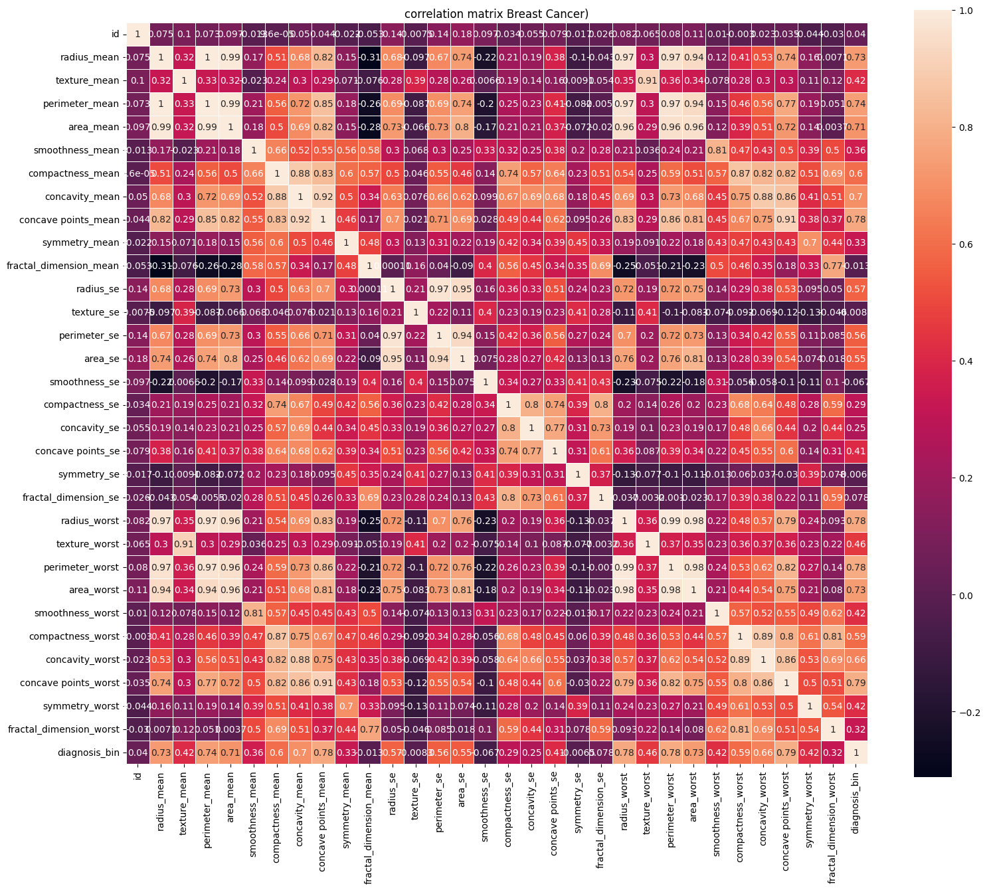
Correlation Matrix

Slide 8
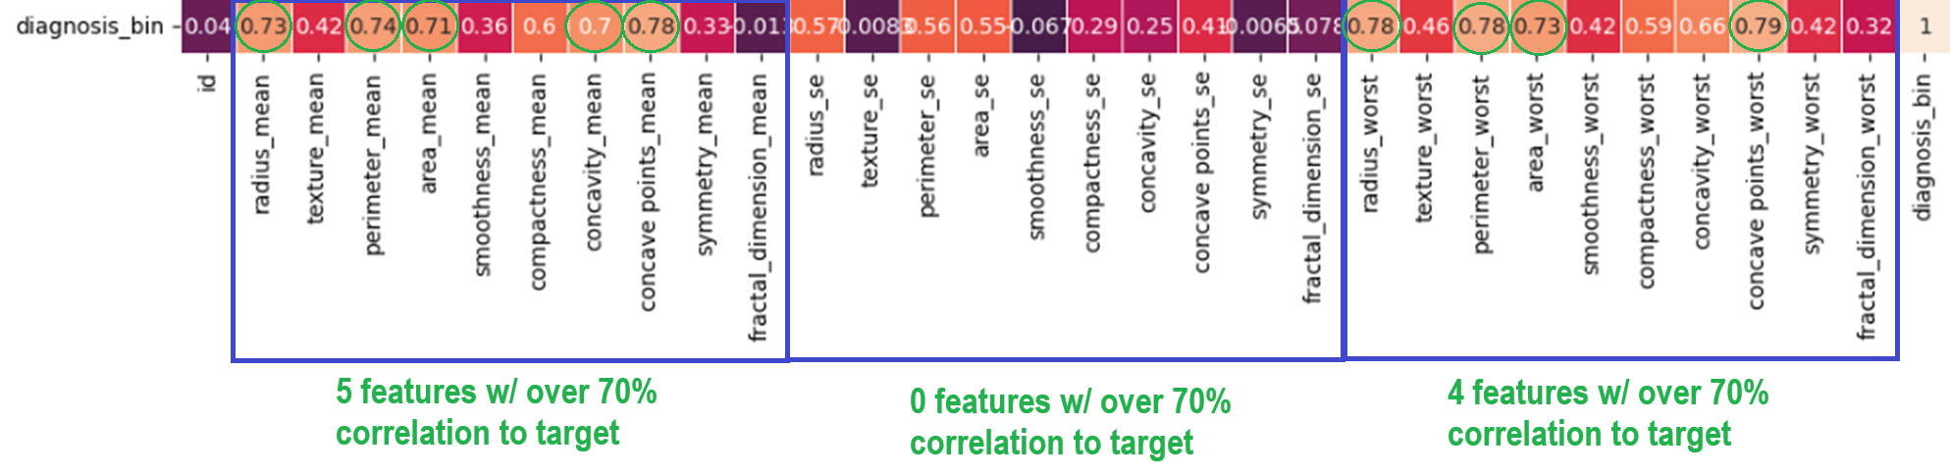
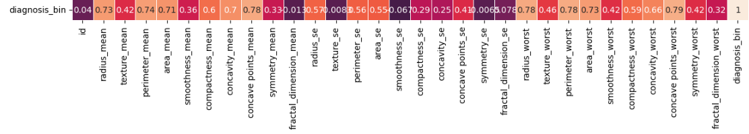
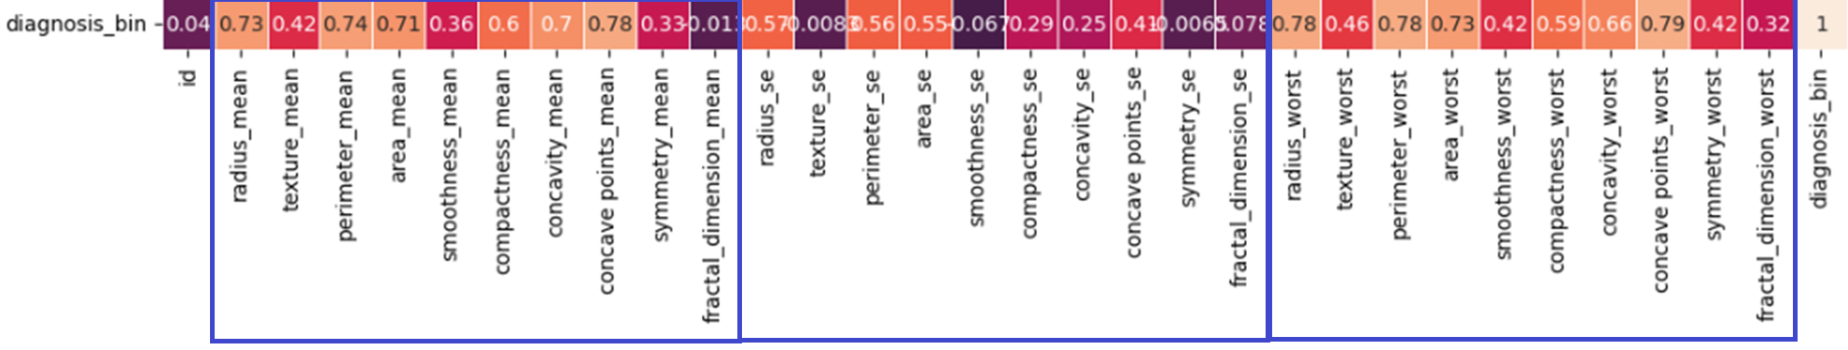
Correlation Matrix

Slide 9
Modeling Process
Overview of models used
Support Vector Classifier (SVC)
Random Forest Classifier
Gradient Boosted Classifier
Data Processing and Feature Engineering
Dropped some features highly correlated to each other
Tuned hyperparameters
Each iteration dropping least important feature
Training and Evaluation methods
Training (80/20), Cross Validation, AUC

Slide 10
Model 1: Support Vector Classifier
Mean Accuracy: 91.2%
AUC: 98.26%
Correct negatives: 96%
Correct positives: 86%
Pros:
High overall accuracy
Good at negative predictions
Cons:
Not as good at positive predictions
Model works best w/ clear separation of categories

Slide 11
Model 2: Random Forest Classifier
Best feature list: area, texture, compactness, and concave points
Mean Accuracy: 93.49%
AUC: 99.34%
Correct negatives: 94%
Correct positives: 98%
Pros:
Very good positive and negative predictions
Very high accuracy
Short, simple feature list
Cons:
This model type is computationally expensive

Slide 12
Model 3: Gradient Boosted Classifier
Best feature list: area, texture, and concave points
Mean Accuracy: 92.79%
AUC: 98.39%
Correct negatives: 96%
Correct positives: 95%
Pros:
Very good positive and negative predictions
Very high accuracy
Shorter feature list
Cons:
This model type is computationally expensive

Slide 13
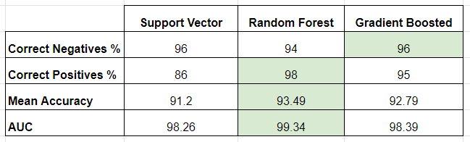
Model Comparison

Slide 14
Conclusions
What measurements are the most important for diagnosing tumors as benign or malignant?
What combinations of measurements give the most accurate predictions?
Most important measurements for most accurate predictions (in order):
Concave points
Area
Compactness
Texture
Benefits to ML model:
Fewer measurements needed for diagnosis
Increased objectivity
Reduced diagnosis time
Reduced misdiagnosis

Slide 15
Questions?

Slide 16
References
https://www.kaggle.com/datasets/kabshaansariya/breast-cancer
https://www.cancer.org/research/cancer-facts-statistics/breast-cancer-facts-figures.html
https://seer.cancer.gov/statfacts/html/breast.html
https://www.ncbi.nlm.nih.gov/pmc/articles/PMC7547332/

